Slide 1
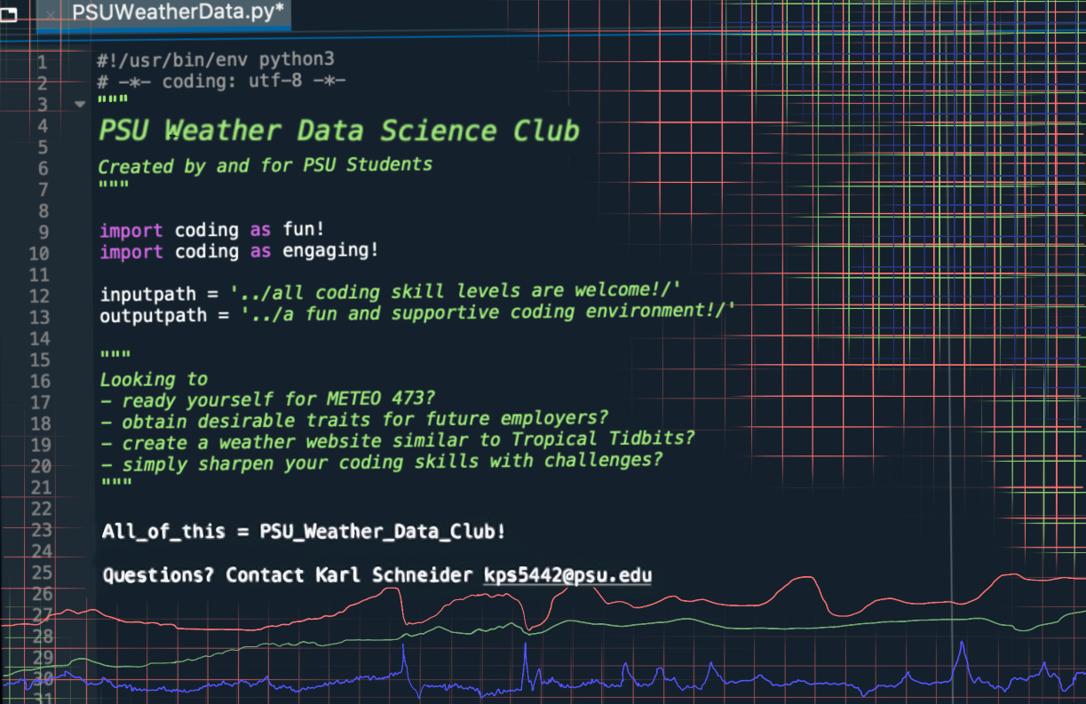

Slide 2
PSU Weather Data Science Club
First Meeting March 24, 2021

Slide 3
About the club
We are a group of students (both undergraduate and graduate) in meteorology, atmospheric science, and related disciplines who are interested in applying computer and data science to solve meteorological problems. We aim to provide our members with valuable coding skills that will prepare them for careers in the private sector, academia, or government. We will collaborate on several projects, including frequent coding challenges and our club's long-term project - the PSU e-Wall redesign.

Slide 5
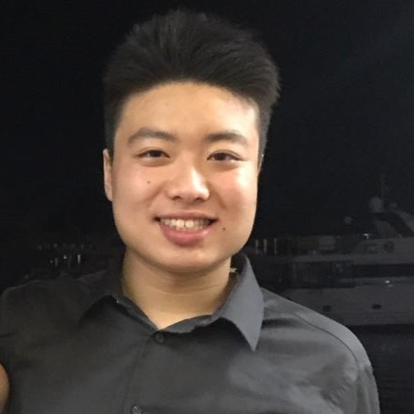
Our Team
Alvin Cheung
Position: Club President
Year: Junior
Meteo interests: Tropical Meteorology, Academia, Education
Other: Driving a manual transmission, skiing, traveling, and food!

Slide 6
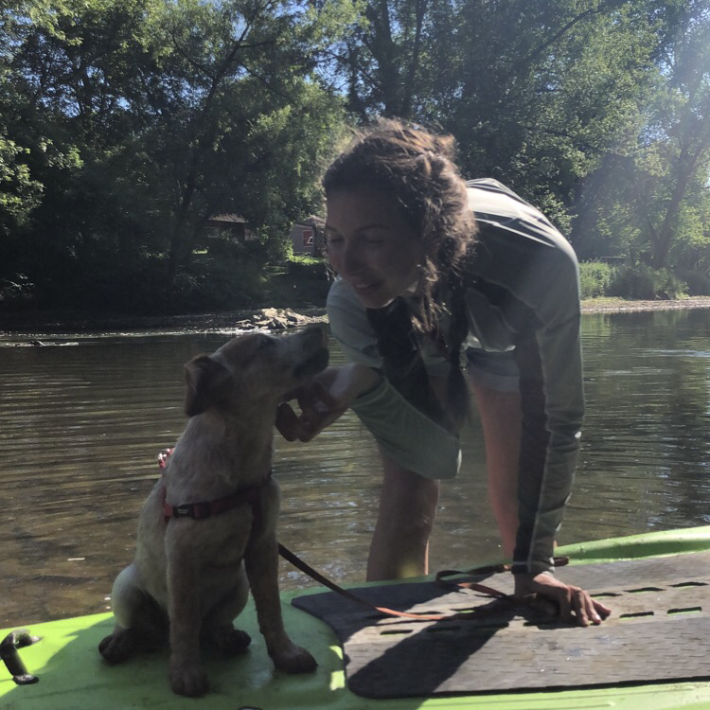
Our Team
Katie Kohlman
Position: Treasurer/Secretary
Year: Junior
Meteo interests: Research in Physical Oceanography and Air-Sea Interactions
Other: rock climbing, paddle boarding, and training my pup (“Goose”)

Slide 7
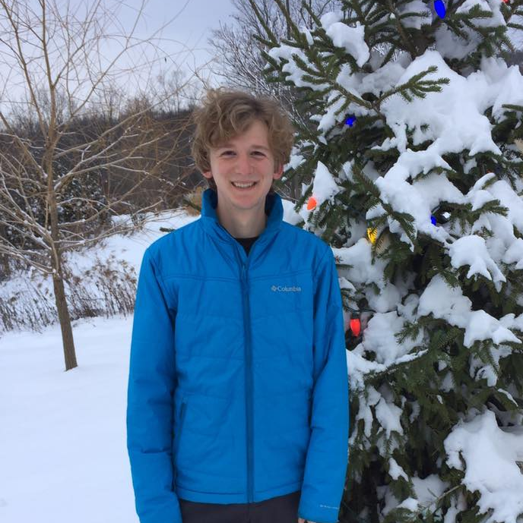
Our Team
Karl Schneider
Position: Student Advisor
Year: B.S. ‘20, incoming grad student
Meteo interests: Operational meteorology, forecasting (winter wx), education
Other: skiing, home snowmaking, baseball

Slide 8
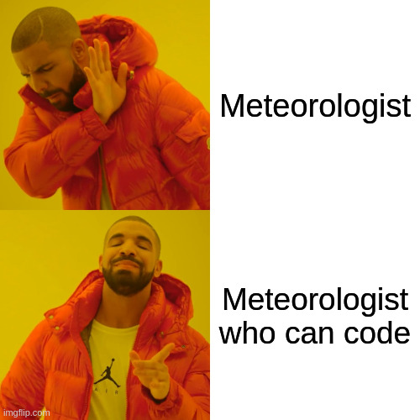
Why learn to code?
Solve real-world problems involving data science
Automate repetitive tasks; make your life easier
Develop an extremely desirable trait for employers and grad schools

Slide 9
Club Activities
Coding challenges
work with others to develop your coding skills on low-stakes projects
enhance your resume and write useful code
Education and guest speakers
introduction to new programming techniques and frameworks
learn from professionals in the industry
e-Wall Redesign
experienced members will collaborate on this highly-visible project
earn e-Wall contributor status through coding challenges and trainings

Slide 10
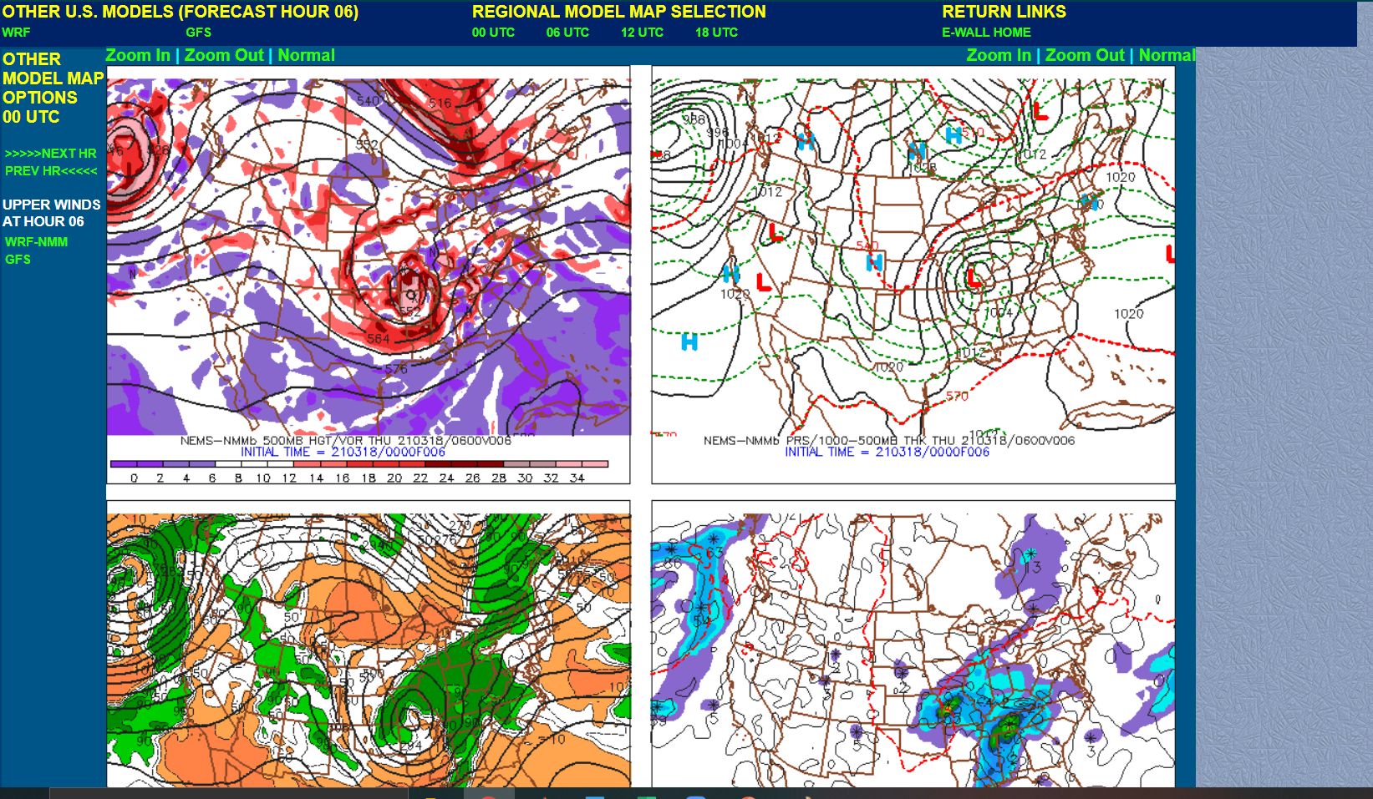
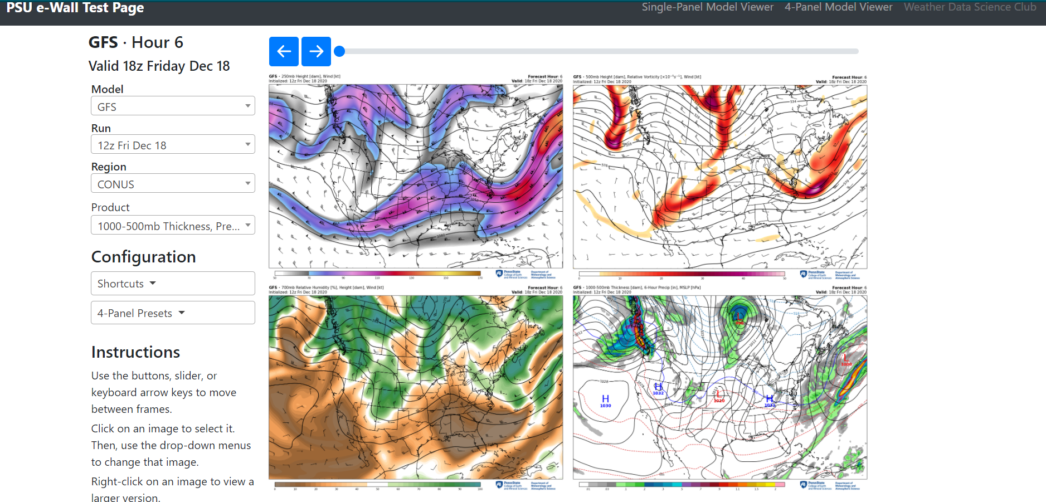
PSU e-Wall Redesign

Slide 11
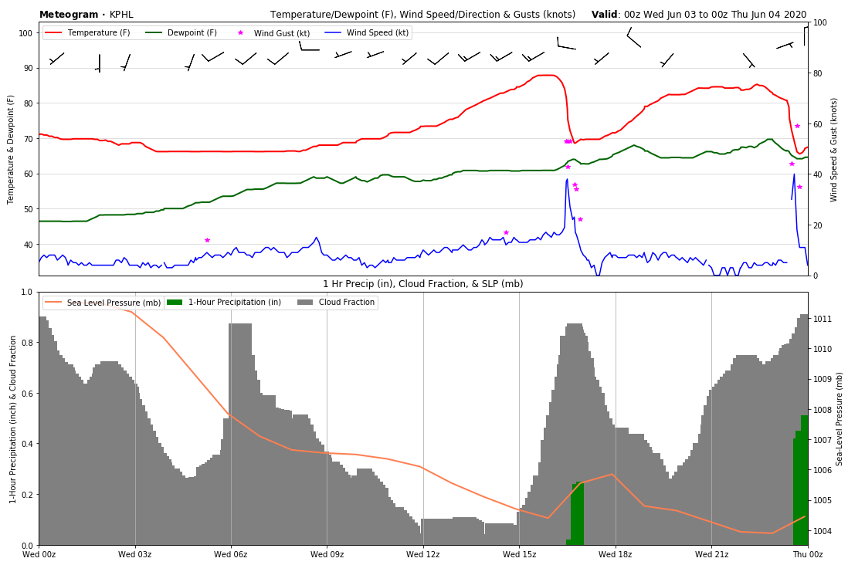
Coding Challenge! Making a Meteogram Plot
Intro to Python and basic plotting
Work with 1-3 other members
Use our JupyterHub server, meteo linux, or your personal computer
Some code provided to start
We will review and discuss each group’s progress at our next meeting
Be creative!

Slide 12
To Access the JupyterLab Server
Click on this link: http://149.165.171.185/
Login with the username that you provided in the Google Form (without @psu.edu)
IMPORTANT: The first time you type your password when logging into the JupyterLab Server will be your permanent password
We will add you to the server as soon as possible. If you still cannot log in 2 days after filling out the form, please contact Karl: kps5442@psu.edu

Slide 13
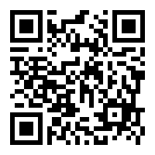
A NEW Google Form
We’ll add you to our club’s exclusive JupyterLab Server
Coding Challenge group assignments
NEW Google Form: https://forms.gle/RaAuVya5n6Zrj28x7
Please take 2 minutes right now to fill out the quick questionnaire. Should take less than 30 seconds.

Slide 14
Where to Find Quick Coding Help/Info When Needed!
GroupMe Chat
Your Coding Challenge Group Members
GitHub Repository: https://github.com/karlwx/wxdatasci
Karl Schneider
kps5442@psu.edu
Alvin Cheung
aac5510@psu.edu

Slide 15
Meeting Plans/Next Meeting Time
We plan on having meeting once every two to three weeks.
Each meetings plans:
Share results from previous week’s Coding Challenge(s)
Guest Speaker or Coding Demonstration from Karl
Introduce a new Coding Challenge
Planned meeting in two weeks from now. Week of (4/5-4/10) Exact time and date TBD.

Slide 16
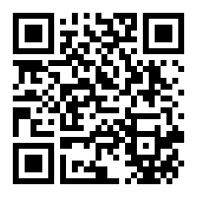
Connect with us!
Join Our GroupMe: https://groupme.com/join_group/62417485/ImOlt7rK
GroupMe QR Code
We will include these slides in a recap email for your future reference!

